Slide 1
CAD Checkers
Creators: Jacob Hugonin, Ado Kurugu, Marco Baca

Slide 2
Intro
With a 3.5" by 3.5" hardwood block, we had to design a product that had some sort of functional use.
In order to create a great product for this project, we took the following steps that followed the design process and more.
1. We defined the constraints.
2. Generated ideas and narrowed down our idea to one master concept for the project.
3. With the master concept in hand, we used a 6-3-5 process to think about what features we wanted.
4. We planned on a way to create the idea with multiple processes.
5. We machined and assembled the idea into a concrete product that is ready for use.

Slide 3
Constraints
Must use a 3.5 inch by 3.5 inch square block with a depth of no greater than 1 inch of cut. Block is 3.5” x 3.5” x 1.5”.
The material for the product will be a hard wood.
The design must have a functional use.
Design must incorporate another material & process than hard wood & the Tormach respectively in the functional use.
The wooden block must be able to be cut by a 2.5-axis CNC machine without resetting the part.
We were allotted a maximum cut time of 40 minutes.

Slide 4
Constraints
Tooling Feed (in per min.) Speed(RPM) Max depth (thousandths of an inch)
T1 1/8 Standard Drill - 0.125 12.0 6,000 1,000
T2 1/4 Standard Drill - 0.25 10.0 4,500 1,000
T3 0.0625 Flat Endmill 20.0 10,000 30
T4 0.125 Flat Endmill 10.0 8,000 1,000
T5 0.25 Flat Endmill 15.0 5,000 1,000
T6 0.125 Ball-Nosed Endmill 15.0 10,000 1,000

Slide 5
Idea for Designs
When conceptualizing our first design, we documented the following options:
Checkers
Charger
Chess
Tic Tac Toe
Bottle Opener
Beer Holder
Charging Block

Slide 6
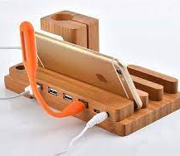
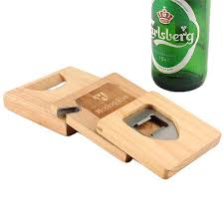
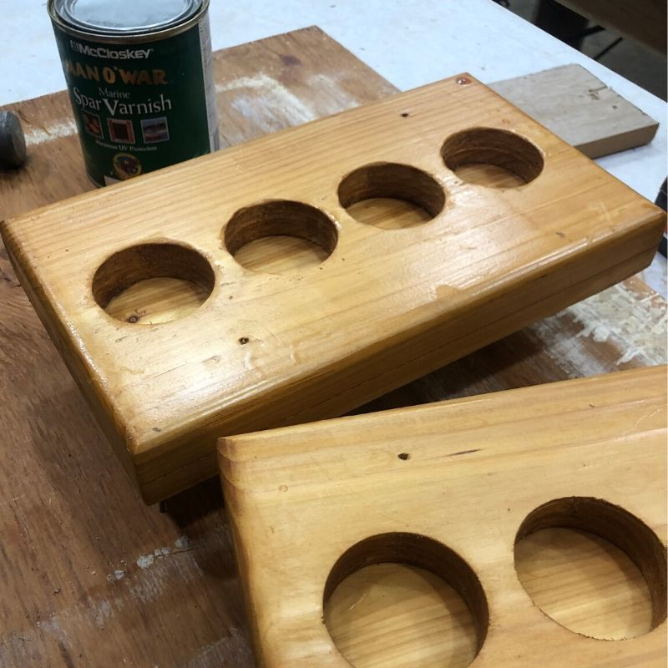
Ideas

Slide 7
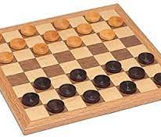
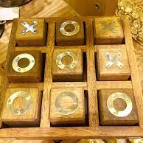
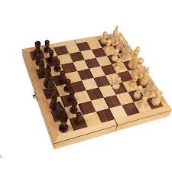
Board Games
We decide that we were going to do a classic board game.
Our constraints allowed us a few options to choose from such as:
- Tic-Tac-Toe
- Checkers
- Chess

Slide 8
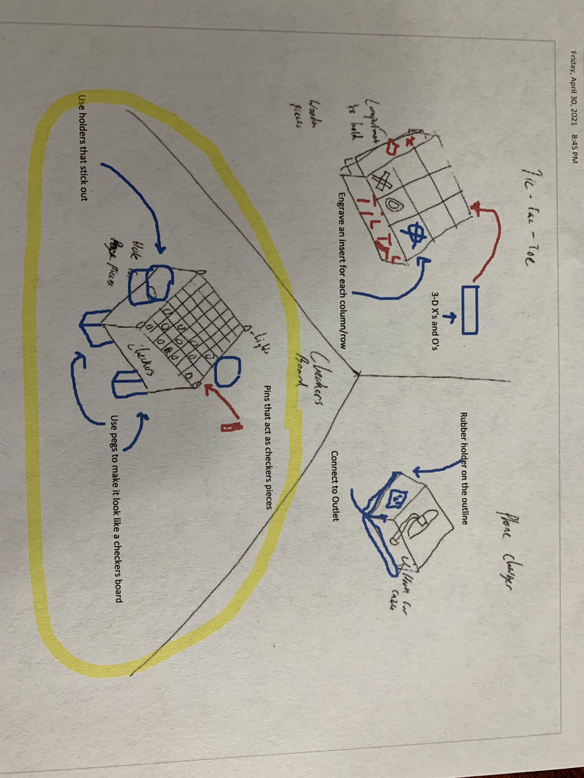
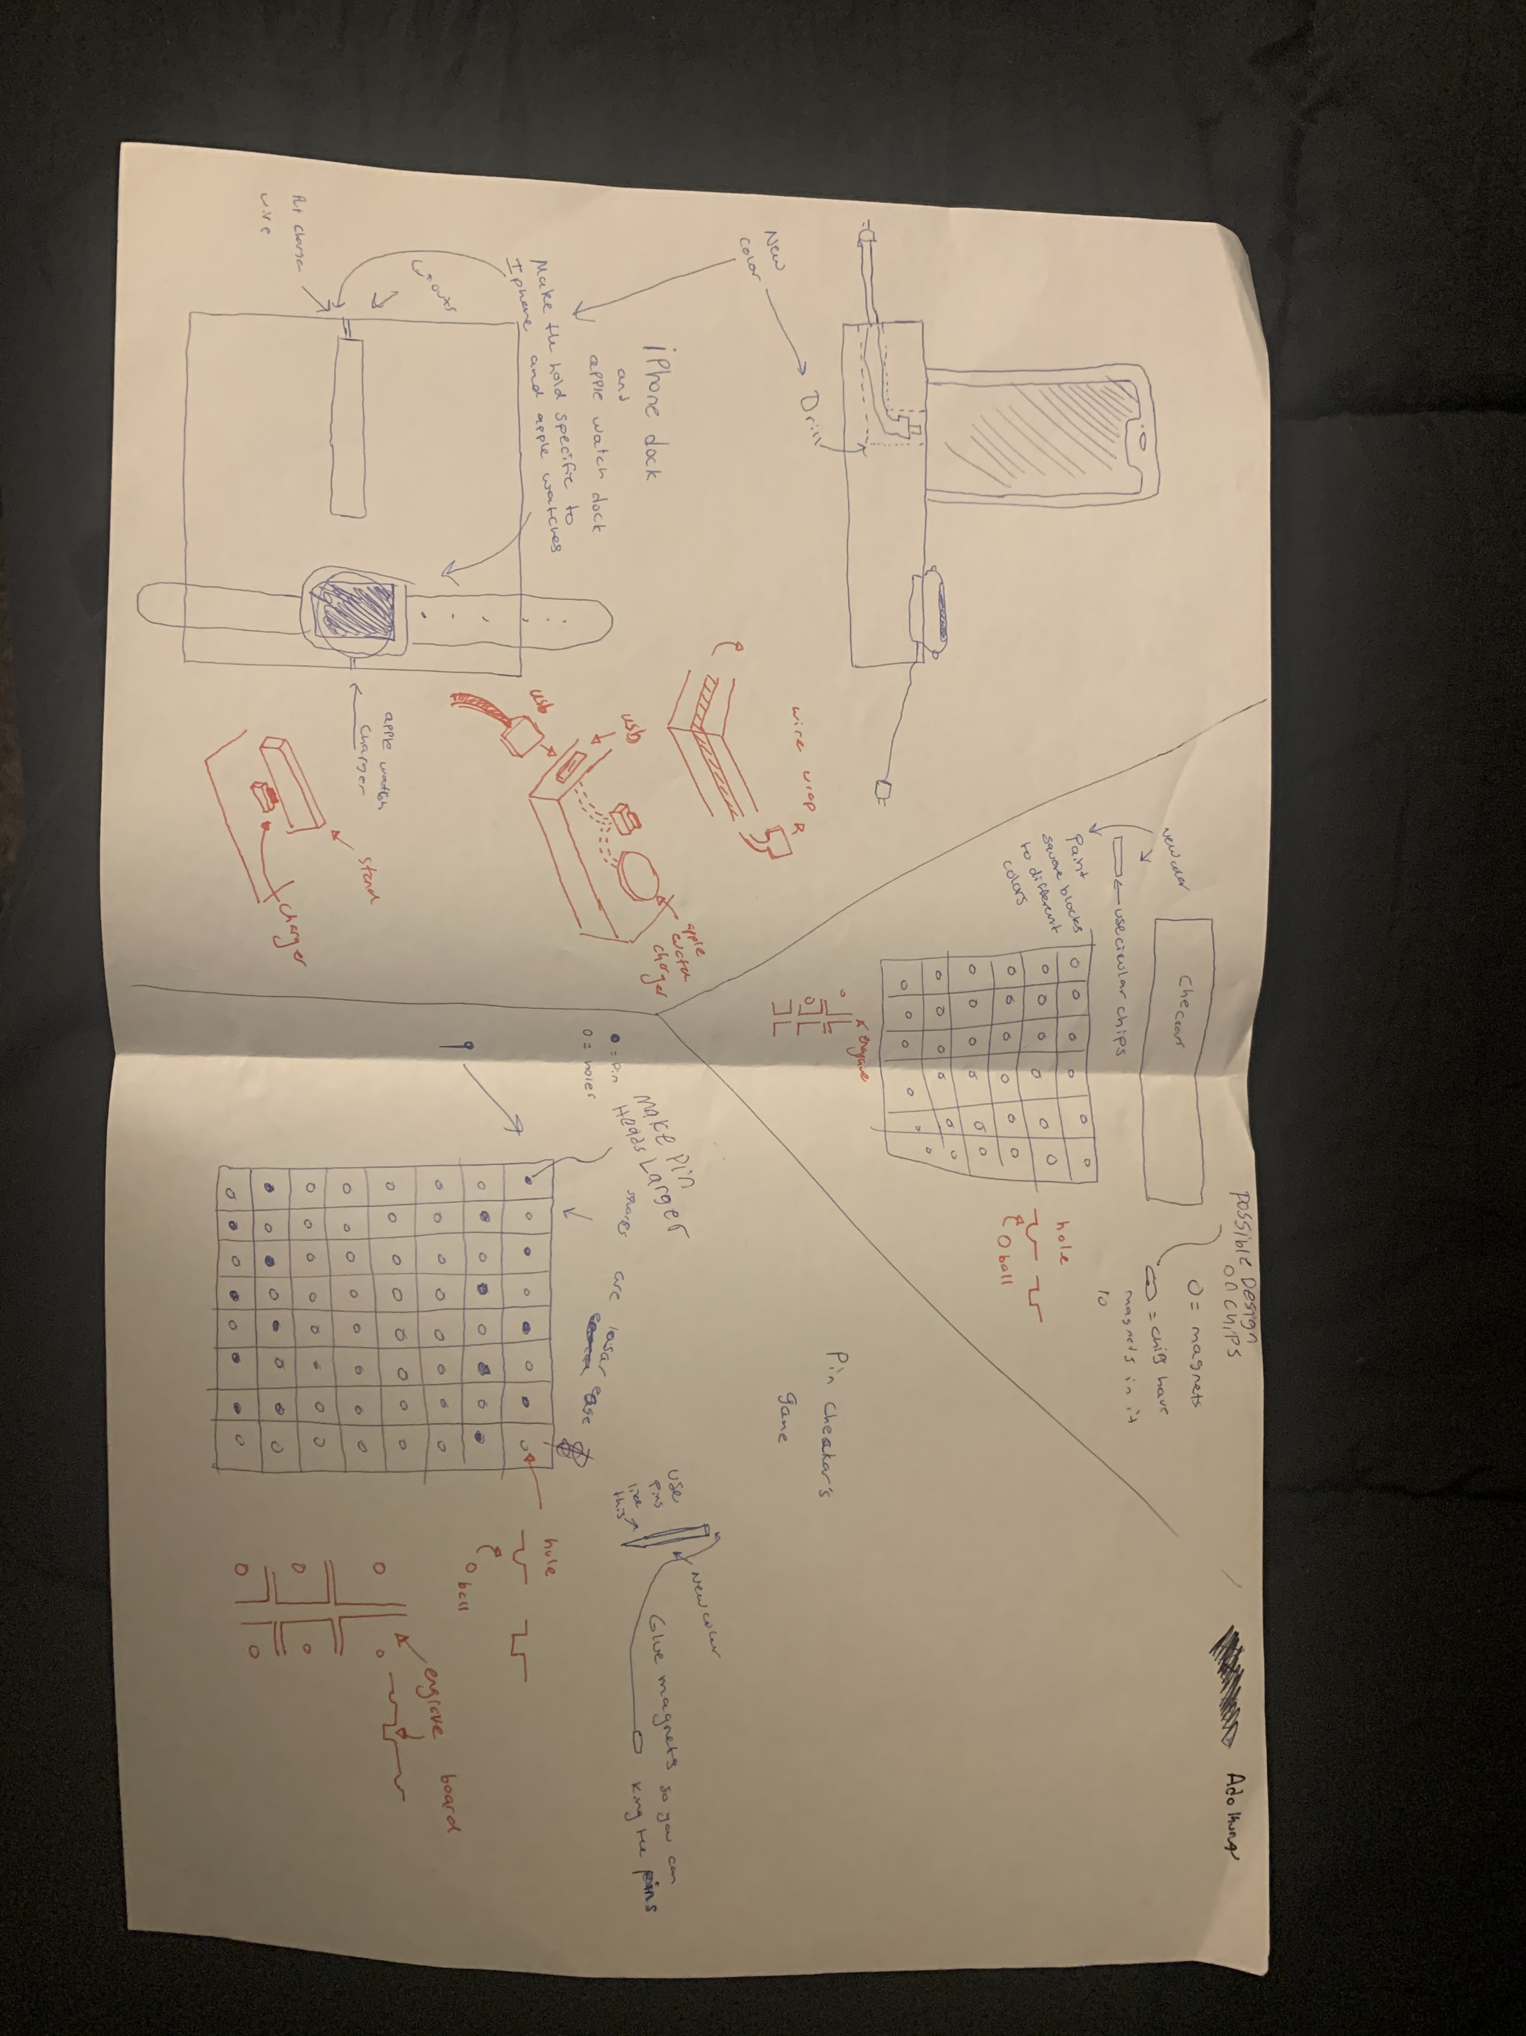
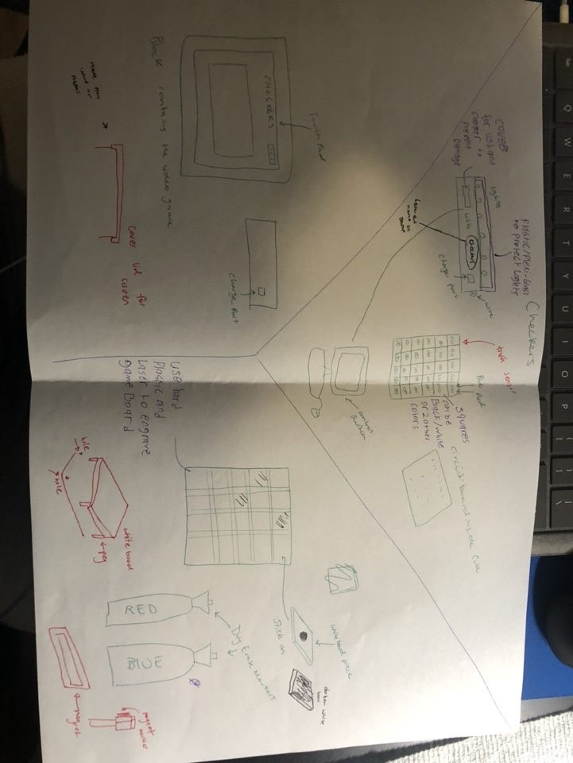
6-3-5

Slide 9
6-3-5 Process
After deciding that we would use the 6-3-5 method for a gameboard, we jotted down designs on each other's concepts.
After the concepts were circled around and annotated by each group member, we collectively decided which parts of our comments and original designs that we would incorporate into the final layout.
We decided that a checkers board with drilled holes would be our final, basic design. This would incorporate 3D printed pins which, when flipped to the painted side, would indicate a "kinged" piece. The final plan also utilized side holders for the pins for easy storage.

Slide 10
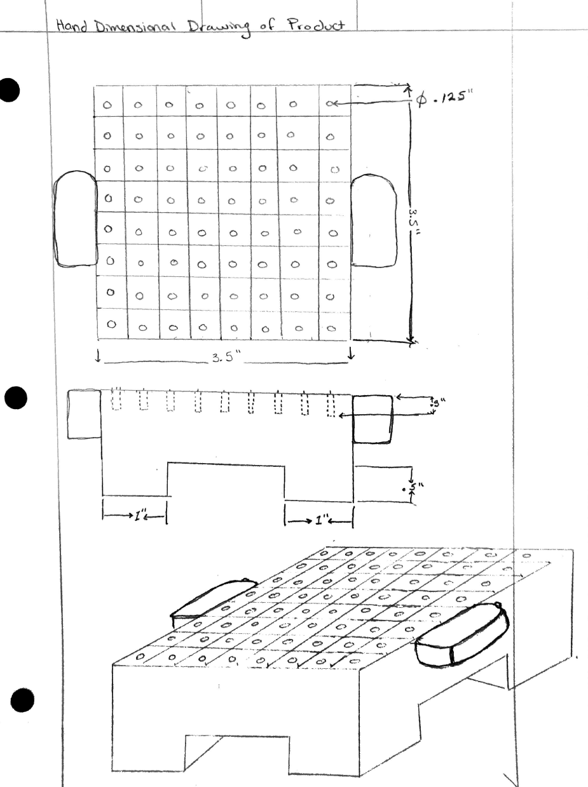
Conceptualized Drawing of Product

Slide 11
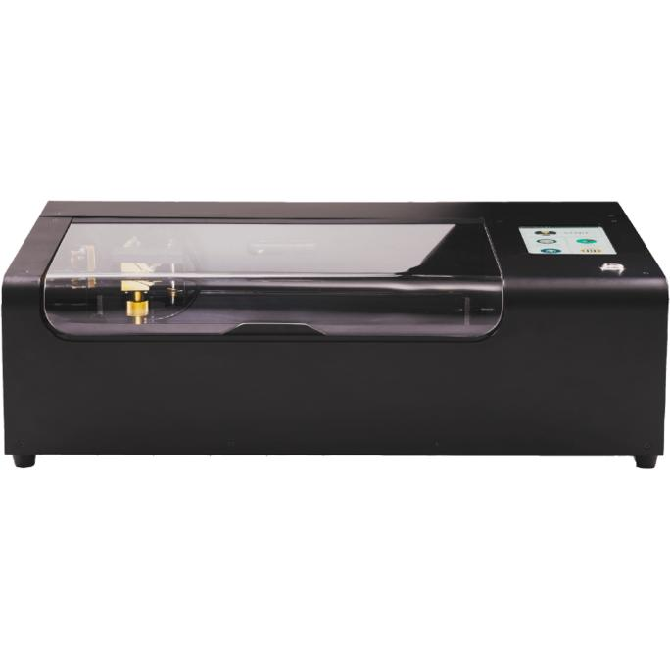
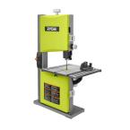
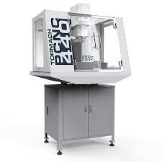
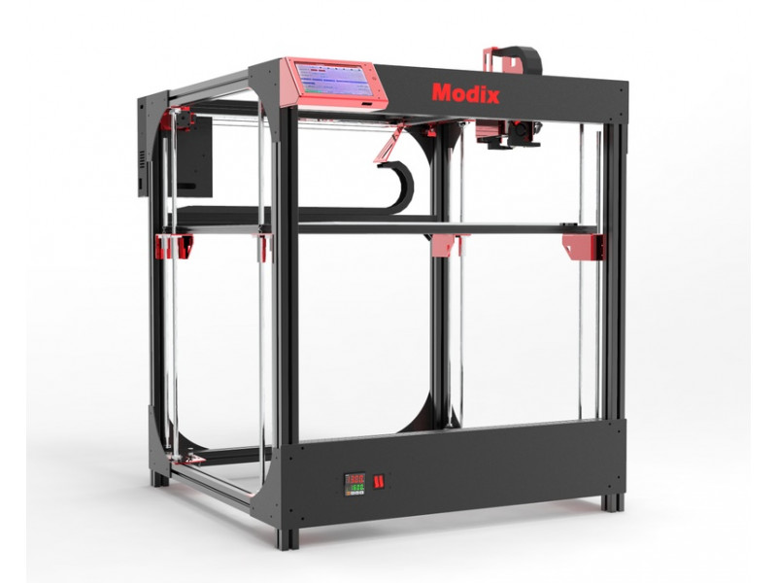
Processes

Slide 12
Processes
Our final design had 4 processes: a Tormach mill, a bandsaw, a 3D printer, and a laser engraver.
We first designed our block in Mastercam. We used a simple contouring profile for the lines and drilling for the pin holes. We spaced the lines equally for an 8 X 8 traditional style checkers board. We then placed circles for the drilling operation in each square.
We tested our program on a piece of scrap wood. When the machining showed an accurate cut, we then proceeded with our project block.

Slide 13
Processes (Cont'd)
After the milling operations, we uploaded our Solidworks model of an extruded pin. This pin design was uploaded into two 3D printers with different colors to distinguish the pins from the other side.
We finalized our block by lasering the title of the game on the front, "CAD Checkers"

Slide 14
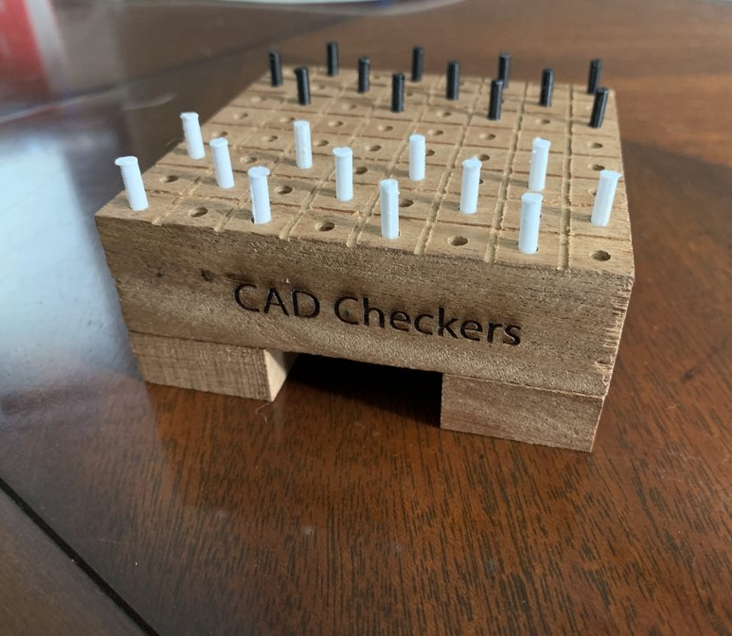
Results

Slide 15
Results
Our design came to fruition, and we made a fully functional checkers board, made entirely by materials and processes found right here in the Makerspace.
Our checkers board is fully functional and aesthetically pleasing. Our design allowed us to build the best combination of our ideas while remaining in the given constraints.
This project provided valuable lessons on how a team can take a simple wooden block and turn it into something functional, unique, and created from a sharing of ideas through the design process.

Slide 16
Questions?

